Slide 1

Introduction to Data Science/Machine Learning
University of Wisconsin Milwaukee
Fall 2025
Sammie Omranian

Slide 2

Girls Who Code – Week 7
Introduction to Machine Learning

Slide 3
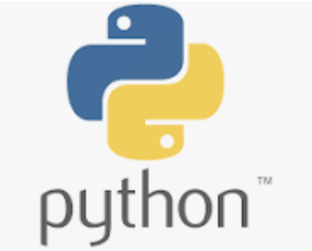
Agenda
Today’s Plan:
What is Artificial Intelligence (AI)?
AI vs. Machine Learning
Train and Test Data
Hands-on – practice
Reflection
🕒 We’ll learn → code → see results → share discoveries!

Slide 4
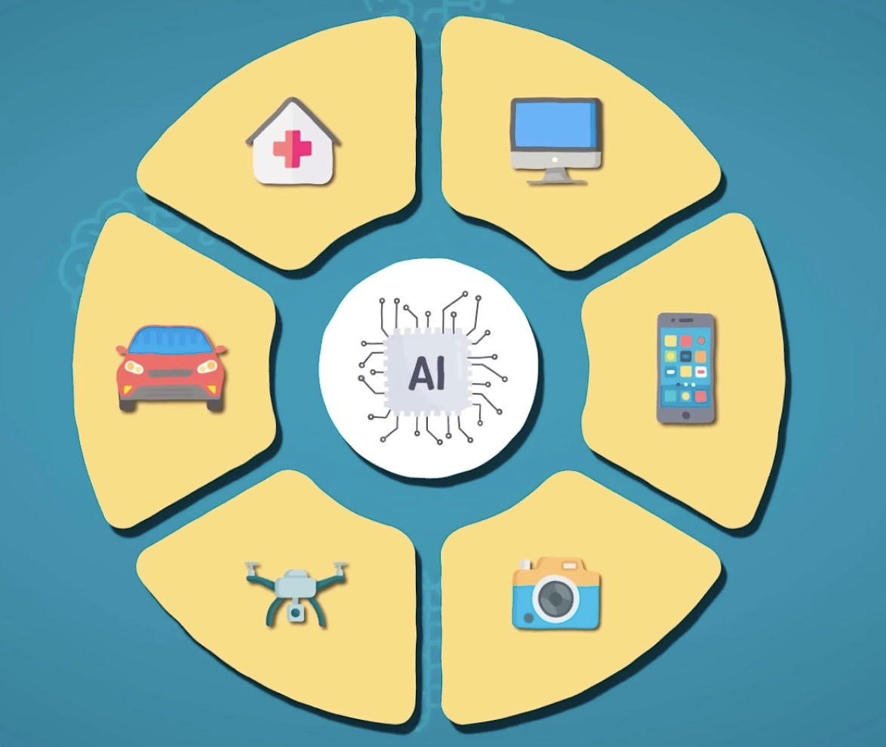
What Artificial Intelligence (AI)?
AI means making computers think and learn like humans — to recognize, decide, and improve with experience.
AI isn’t just robots — it’s behind apps we use every day.
Siri, ChatGPT, Netflix, and Snapchat filters all use AI in different ways.
AI = “teaching computers to be smart.”
Image credit

Slide 5
Examples of AI in Everyday Life
🎶 Spotify: learns your taste to recommend songs
🗺️ Google Maps: finds the fastest route
📱 TikTok: learns what you watch
🩺 Healthcare AI: detects early signs of illness

Slide 6
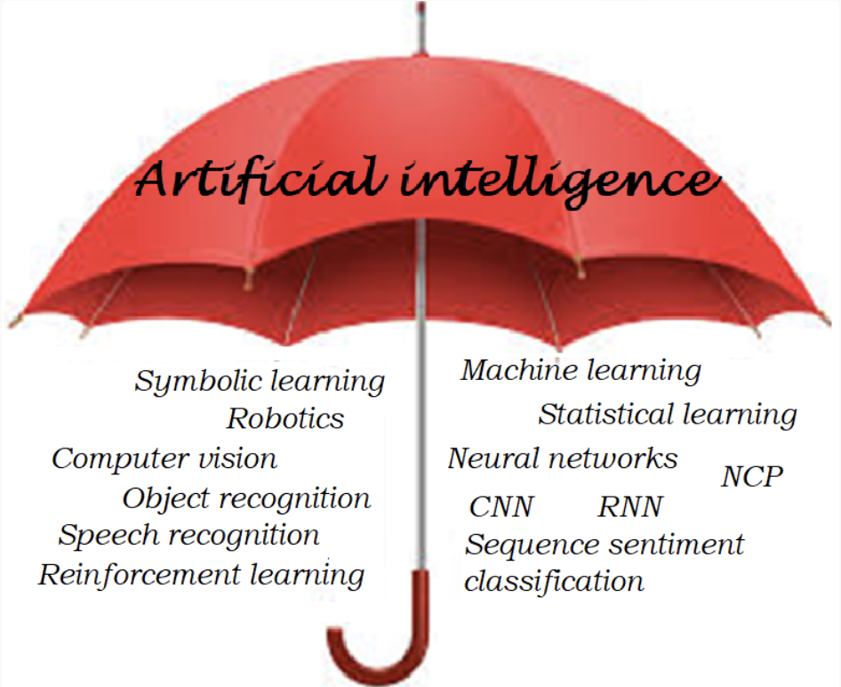

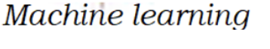
What is Machine Learning (ML)?
Machine Learning (ML) is a part of AI that learns from data instead of being programmed with rules.

Slide 7
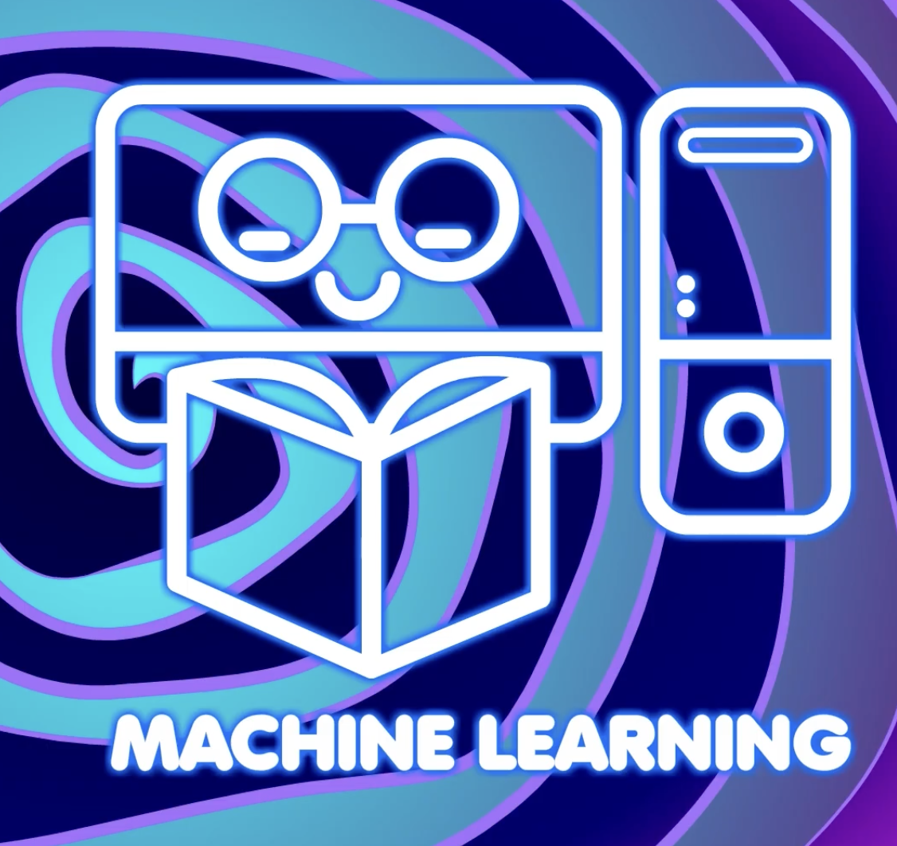
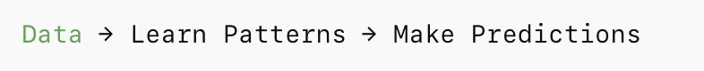
How Machine learns?
Computers learn by finding patterns in data.
We can use those patterns to make predictions.
That’s what we’ll do today!

Slide 8
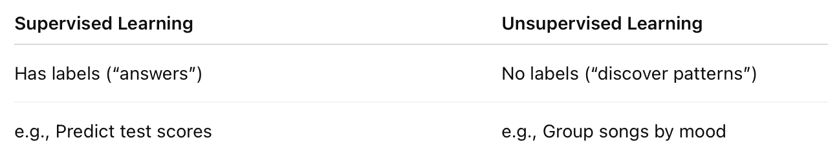
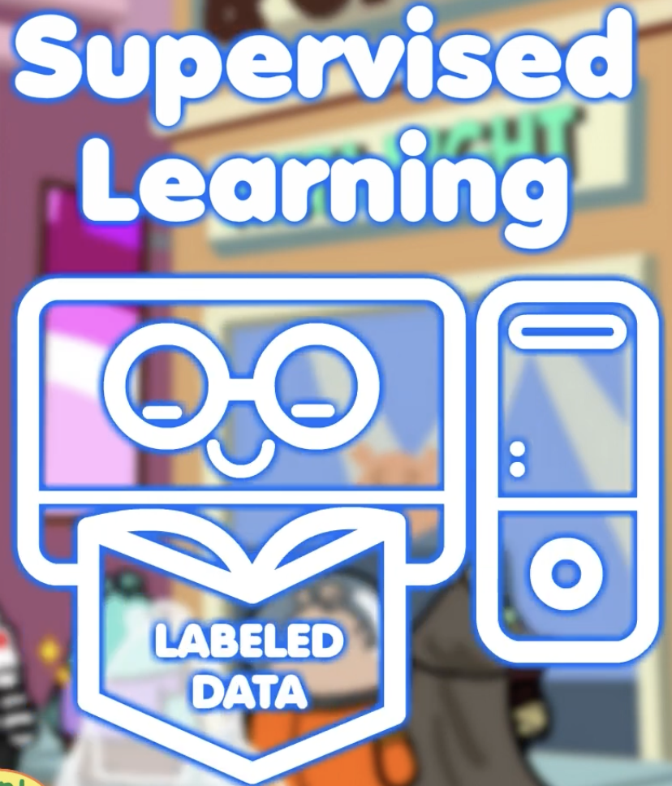
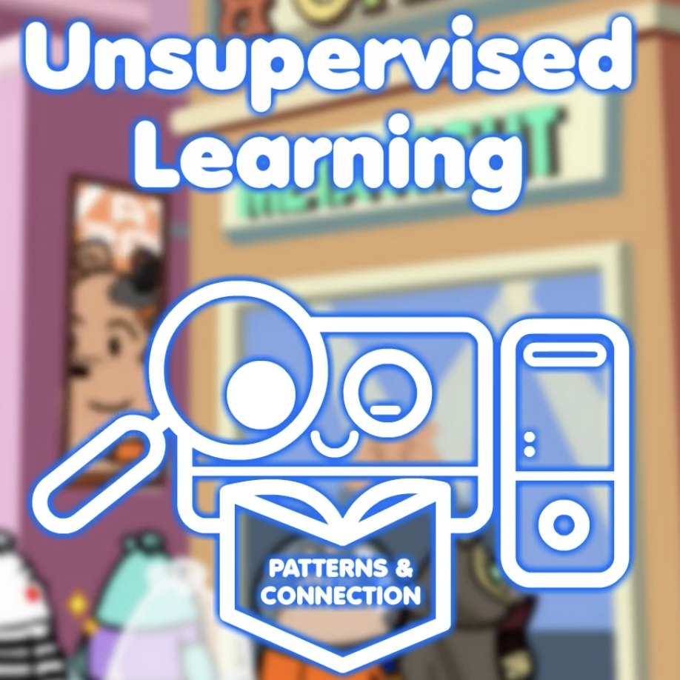
Types of Machine Learning

Slide 9
Supervised Learning in Real Life!
In supervised learning, we teach the computer using examples that already have answers (labels).
How YouTube recommend videos to its users?
YouTube ▶️ → learns from “liked👍 / not liked👎 ” videos
How Spotify recommend songs to the listener?
Spotify 🎶 → learns from “liked / skipped” songs

Slide 10
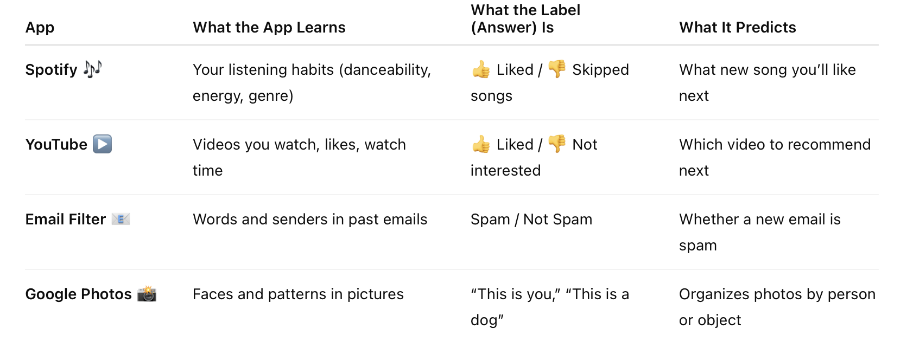
Supervised Learning in Real Life!

Slide 11
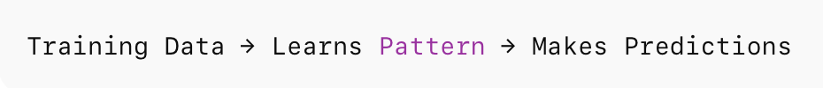
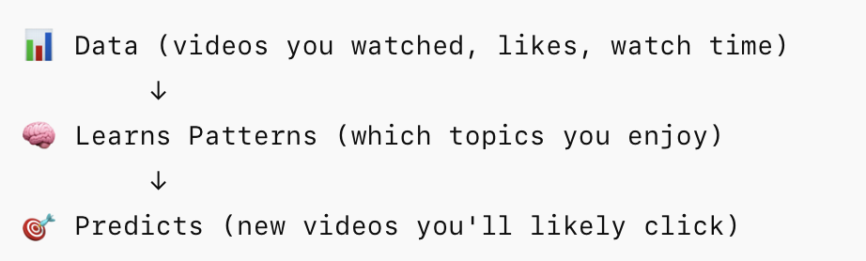
How the Computers Learn?
Example:
YouTube
YouTube learns by watching your behavior — what videos you click, how long you watch, and what you skip.
It uses those examples (data) to learn patterns and then predict what you’ll want next.

Slide 12
How the Computers Learn?
Example:
YouTube
YouTube collects features like video category, length, watch time, and user likes.
The “label” or “answer” is whether you watched or skipped the video.
The model learns patterns — e.g.,
“If the video is about coding + under 10 minutes + educational, this user likely watches it.”
Then it predicts what to recommend next!
This is the same logic we’ll use soon — but with simpler data.

Slide 13
Can YouTube Be Wrong?
✅ “Recommended video you actually liked”
❌ “Video that totally missed your interest”
“Sometimes the computer thinks it knows you… but it’s wrong!” 😅
Even smart AI systems make mistakes.
Why? Because they may have learned from limited or biased examples.
We need to test the model on new data to see how well it truly been trained!

Slide 14
Train and Test Data
YouTube is trained on millions of examples — what people click, like, or ignore.
But if it only learned from some users or certain types of videos, it may make bad guesses for others.
That’s why in machine learning; we don’t test on the same data we trained on.
We split our data into two parts:
Training data: to help the computer learn patterns
Testing data: to check if it can predict correctly on new examples

Slide 15
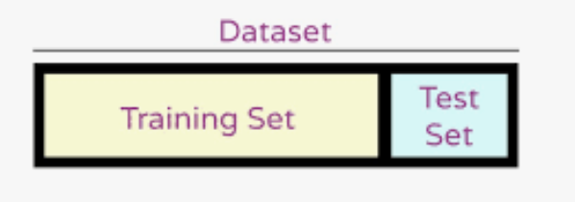
Train and Test Data
80%
20%
Most of the data helps the computer learn.
A small portion is kept aside to evaluate performance.
In Python, we’ll use a built-in function to do this automatically.

Slide 16
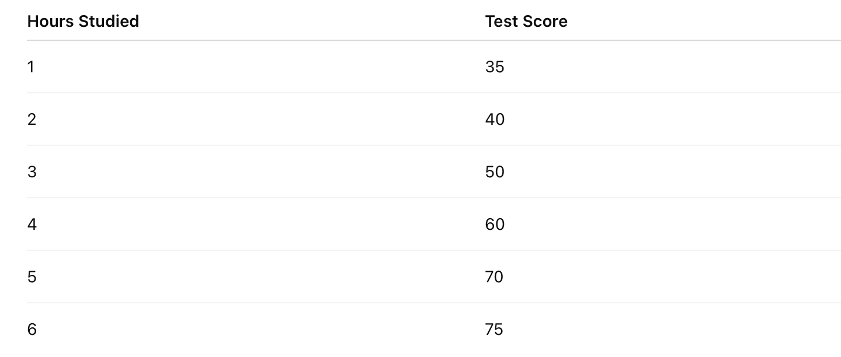
Hands-On Practice – Let’s Code
Let’s Build Our First Machine Learning Model!
We’ll teach the computer to predict test scores from hours studied — just like YouTube learns to predict what you’ll watch next!
Our data will have features (hours studied) and labels (scores).
The computer will learn the pattern — a line of best fit.

Slide 17
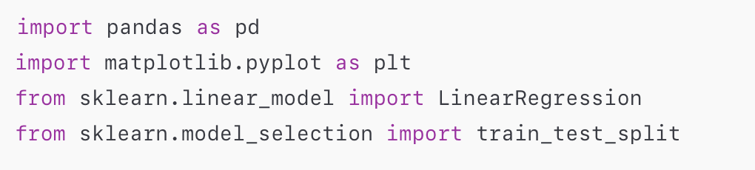

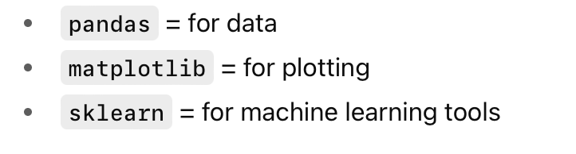
Hands-On Practice – Let’s Code
Step 1: Import Libraries and Data
🧩 Try in Python:
What are these libraries?

Slide 18
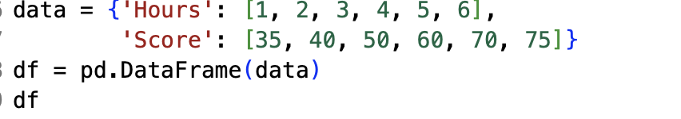
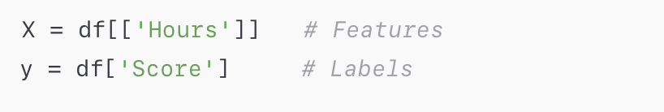
Hands-On Practice – Let’s Code
Features and labels – X and Y
🧩 Try in Python:

Slide 19
Hands-On Practice – Let’s Code
✂️ Step 2: Split Data into Train/Test Sets
We divide our data into two groups:
Training data (80%) → the computer learns from this.
Testing data (20%) → we check if it really learned.
test_size=0.2 means 20% for testing and 80% for training.
random_state=42 just makes sure we get the same random split each time we run it.
🧩 Try in Python:

Slide 20
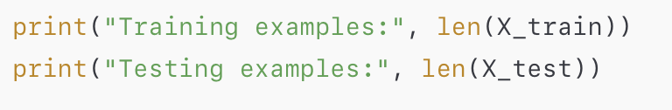
Hands-On Practice – Let’s Code
✂️ Step 2: Split Data into Train/Test Sets
We “train” the model on most of the data.
We “test” on a smaller part to see how it performs on new data.
Here, 80% train / 20% test.
It is like: Studying with Flashcards! (train = study cards, test = quiz cards).
🧩 Try in Python:

Slide 21

Google Colab – Our Coding Hub Where we’ll write, run, and share all our Python code

